Slide 1
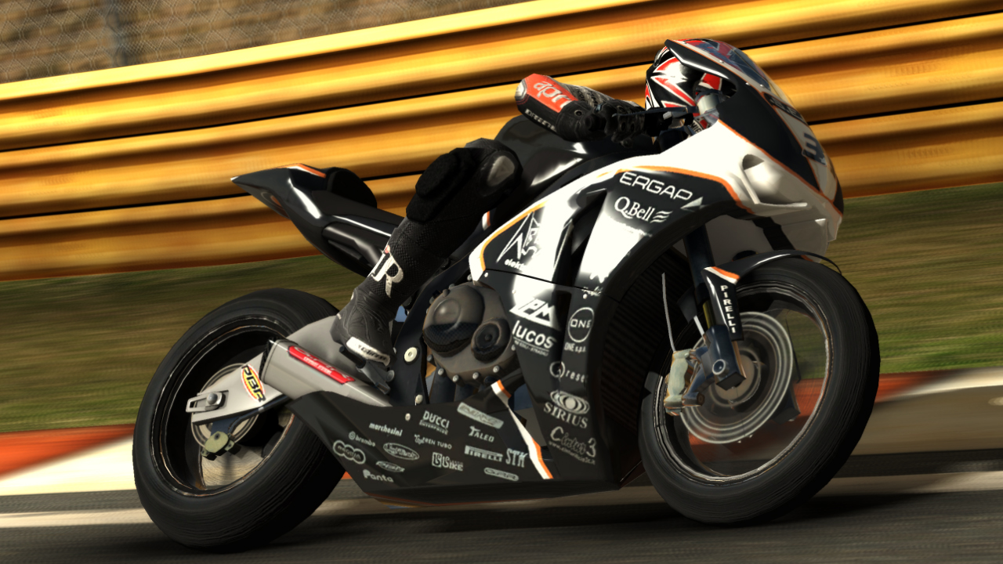
Physics-based Racing AI
Paolo Maninetti (Milestone s.r.l)

Slide 2

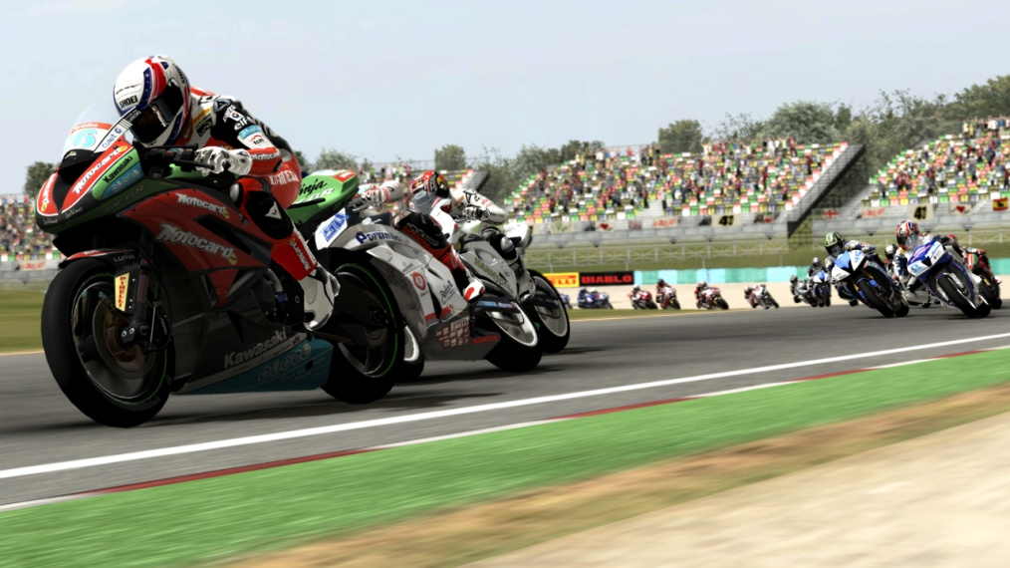


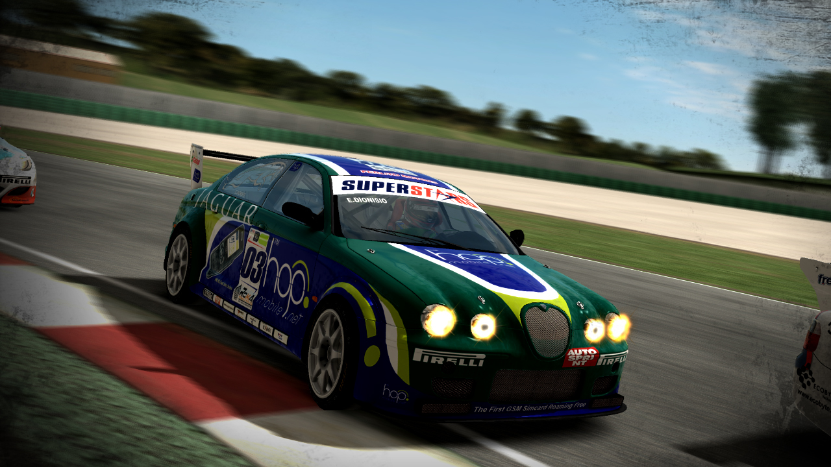


Slide 3
Overview
Part 1 – Racing AI Tutorial
Basics in Steering, Throttle & Brake managment
Group behaviours (avoiding, overtakes)
Part 2 – A method for optimizing AI performances
Fairness in racing games
Main alghoritm for an AI optimizator

Slide 4
RACING AI TUTORIAL
Part 1

Slide 5
AI - Physics interface
AI
Physics
Position
Input: Steer, Throttle, Brake, ...
Position, Direction, Speed, ...

Slide 6
AI - Physics interface
Physics as a black box (too much complexity to forecast exactly the results of an action)
Physics changes during the project

Slide 7
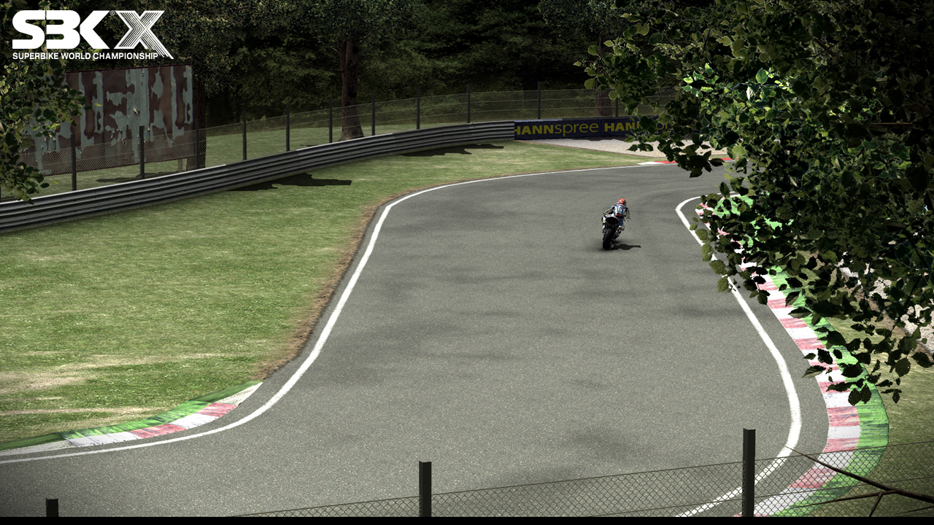
Racing Line
Edited Line
Generated Line

Slide 8
Representation
Segments & Fixed Radius Curves

Slide 9
Representation
Splines (hermite)
Edit Nodes (pos)
Edit Tangents (dir & len)

Slide 10
Sampling the racing line
Sample:
Position
Border Right Distance
Border Left Distance
Radius
...

Slide 11
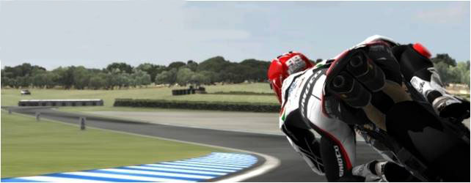
Following the racing line
Basic:
Steer = Angle * Factor
Angle
Target

Slide 12
Following the racing line
Advanced:
Steer = Lean which resulting radius
leads to the target (given current speed)
Target

Slide 13
Throttle and Brake managment
25 m/s
40 m/s
55 m/s
60 m/s

Slide 14
Throttle and Brake managment
Basic implementation:
Speed < Speed Target ? Throttle = MAX
Speed > Speed Target ? Brake = MAX
Better implementation uses Throttle and Brake modulation (could model also driver characteristics, like aggressiveness or smoothness in driving)

Slide 15
Recovery Mechanics
Mechanics that detect a dangerous situation and apply an action to restore a safer situation
AI that detect too much dritfing uses counter steer (car)
AI that detect a big angle with the target uses a rear brake (bike)
Drawback: loss of performances

Slide 16
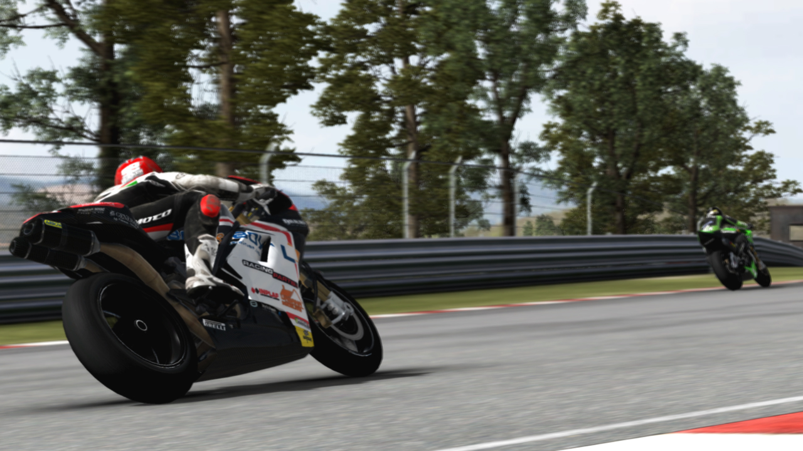
Avoiding
Collision Sphere

Slide 17
Avoiding
50 m/s
40 m/s
Impact time
10 secs
3 secs
Brake to 40 m/s

Slide 18
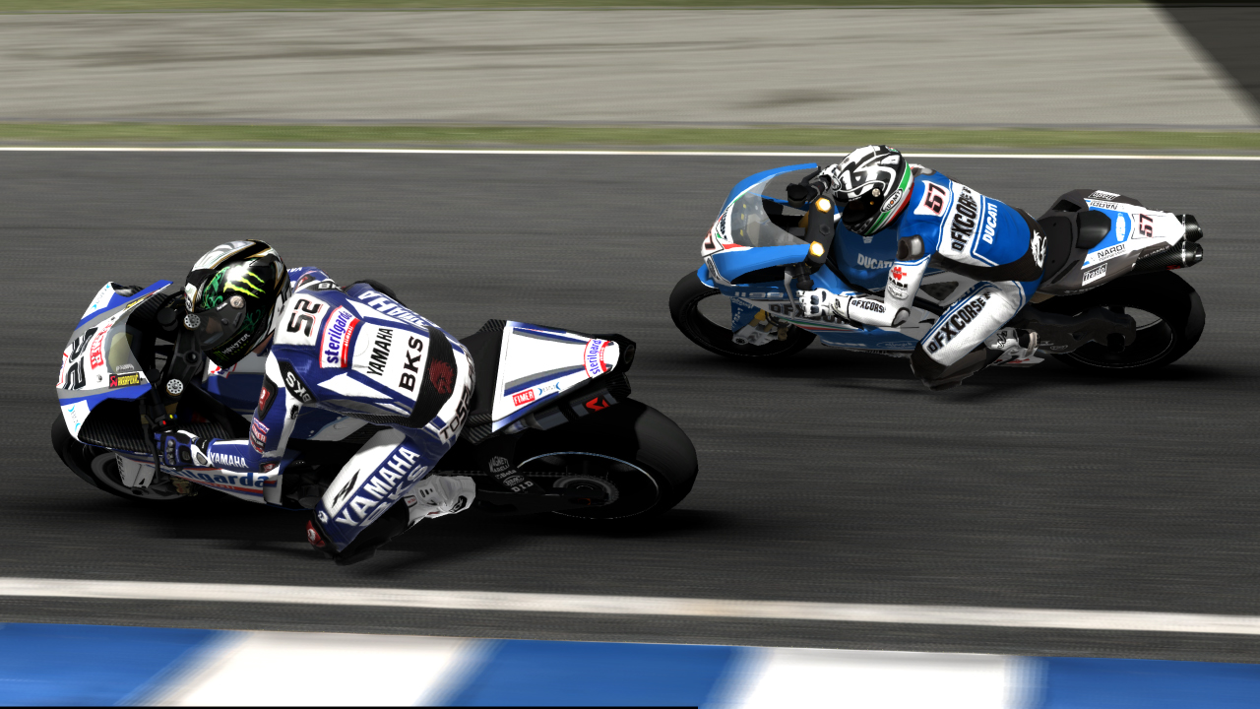
Overtake
Overtake direction
50 m/s
40 m/s

Slide 19
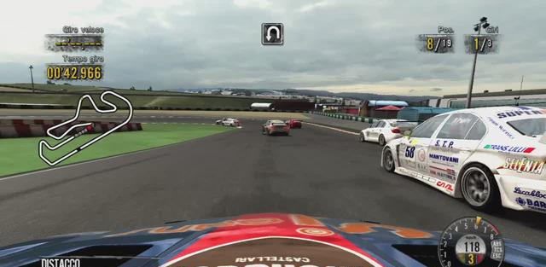
Overtake
4 meters

Slide 20
Overtake
Adding component to steer (Steer = SteerToTarget + C)
Fast reaction
Can increase/decrease dynamically the component
Harder to control distances and deviating speed
Considering more vehicles
Calculating the overall occlusion
Finding the nearest free block

Slide 21
Mistakes
“Natural” errors
Collisions
Losing control in overtake/group situations
Generated errors
Steering, Throttle, Brake
Falls (bike): low side, high side

Slide 22
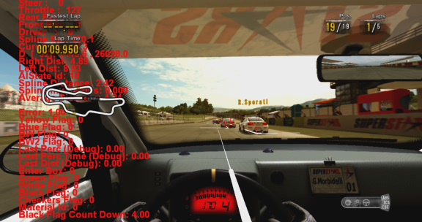
Car AI

Slide 23
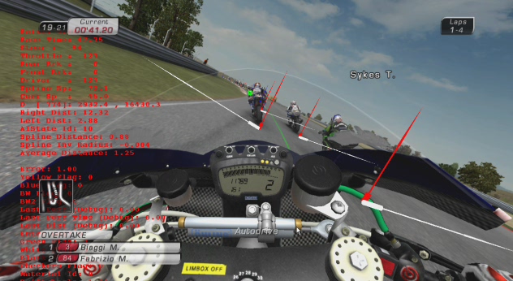
Bike AI

Slide 24
A METHOD FOR OPTIMIZING AI PERFORMANCES
Part 2

Slide 25
Fairness in racing games
Common trick is using simplified (or helped) physics for Ais
Easier to obtain good performances (and tune)
Easier managing group situations
Visual effect not too realistic
Difficult to maintain a fair situation with the player

Slide 26
Fairness in racing games
Using (almost) the same player physics
Much better under a visual point of view (realism)
AI can’t do something that player can’t so fairness is guaranteed
Much more difficult to obtain good performances
More difficult also managing group situations
Need a better method than simple speed precalculation

Slide 27
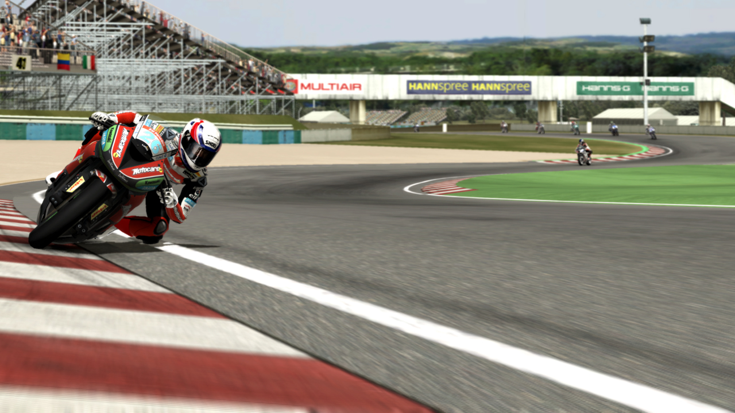
Speed precalculation
F = m*speed^2/radius
Radius
Grip
MaxSpeed = sqrt(grip*G*radius)

Slide 28
Speed precalculation
23 m/s
35 m/s
25 m/s
40 m/s
15 m/s (min speed in the turn)
Deceleration

Slide 29
Speed precalculation
You can tweak the precalculation affecting the grip and deceleration values the alghoritm consider (not the real grip and brakes)
Solution would never be optimal (improve in some points but exit from the track in others, or stay into the track but still too slow in some sectors)

Slide 30
Dividing into sectors
MaxSpeed = sqrt(grip*grip_mod_2*G*radius)
Sector 2 (Grip Mod 2, Dec Mod 2)
Sector 1 (Grip Mod 1, Dec Mod 1)
MaxSpeed = sqrt(grip*grip_mod_1*G*radius)

Slide 31
Iterative method
Detect sectors in an automatic way
Start when inverse radius != 0, end when inverse radius returns 0
Make the AI drive (graphics disabled)
Act on grip and deceleration modifier
Define a step
Increase grip modifier for higher speeds
Increase deceleration modifier for more aggressive approach

Slide 32
Iterative method
Increment modifiers as soon as lap time decrease
One lap could not be sufficient (starting conditions). Up to 5 laps for evaluation.
Pass to an other sector when lap time does not decrease any more
First pass on grip modifiers, second pass on decelerations
More iteractions could help (restart the process)

Slide 33
Extra conditions
Considering only lap time is often not sufficient
Need extra conditions to be satisfied
Out of track check
Distance from ideal line
Others (skid, wobble, wheelie, …)
Invalidate single lap or the entire trial when a condition is not satisfied

Slide 34
Resulting Data
Stored as a track asset
For each sector: start sector info, end sector info, grip modifier, deceleration modifier
Speeds are calculated at initialization time taking in account generated modifiers
Flexibility in case of ideal line or grip changes

Slide 35
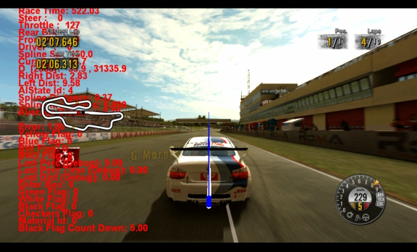
Not optimized lap

Slide 36
Grip modifiers
BestTime = 128.11
Grip Modifier 0 = 1.00
BestTime = 127.76
BestTime = 127.45
BestTime = 127.21
BestTime = 127.10
Grip Modifier 1 = 1.40
BestTime = 126.93
BestTime = 126.80
BestTime = 126.70
BestTime = 126.63
Grip Modifier 2 = 1.40
...

Slide 37
Deceleration modifiers
BestTime = 114.59
Dec Modifier 0 = 1.00
BestTime = 114.51
BestTime = 114.38
BestTime = 114.28
BestTime = 114.23
BestTime = 114.19
Dec Modifier 1 = 1.50
BestTime = 114.18
Dec Modifier 2 = 1.10
Dec Modifier 3 = 1.00
Dec Modifier 4 = 1.00
...

Slide 38
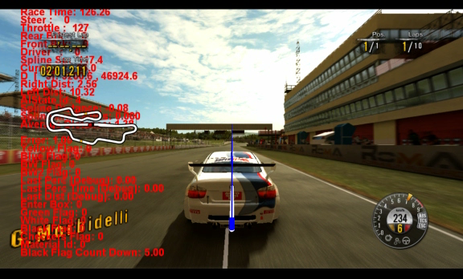
Optimized lap (no extra conditions)

Slide 39
Adding extra conditions
Example
No out of track
Ideal line distance < 3 meters (CM of vehicle)

Slide 40
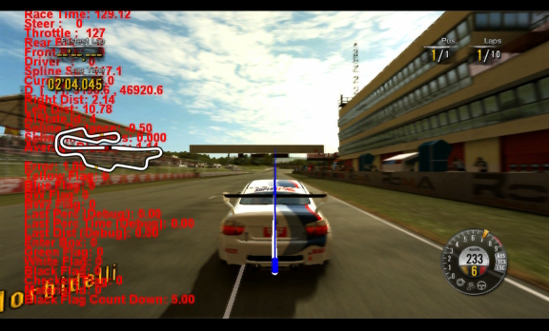
Optimized lap (with extra conditions)

Slide 41
Advantages
Simple implementation
Editable results
Speeds are still proportional to the radius
Can tweak by affecting the (real) grip (but not too much)

Slide 42
Possible improvements
Step managment
Order optimization
Extra conditions
Acting not only on speeds (driving parameters)

Slide 43
Conclusions
Fairness is very important
Difficult to forecast physics (and track)
Trying and see what happen is a good solution

Slide 44
Thanks!
www.milestone.it

